Slide 1


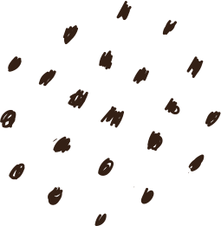


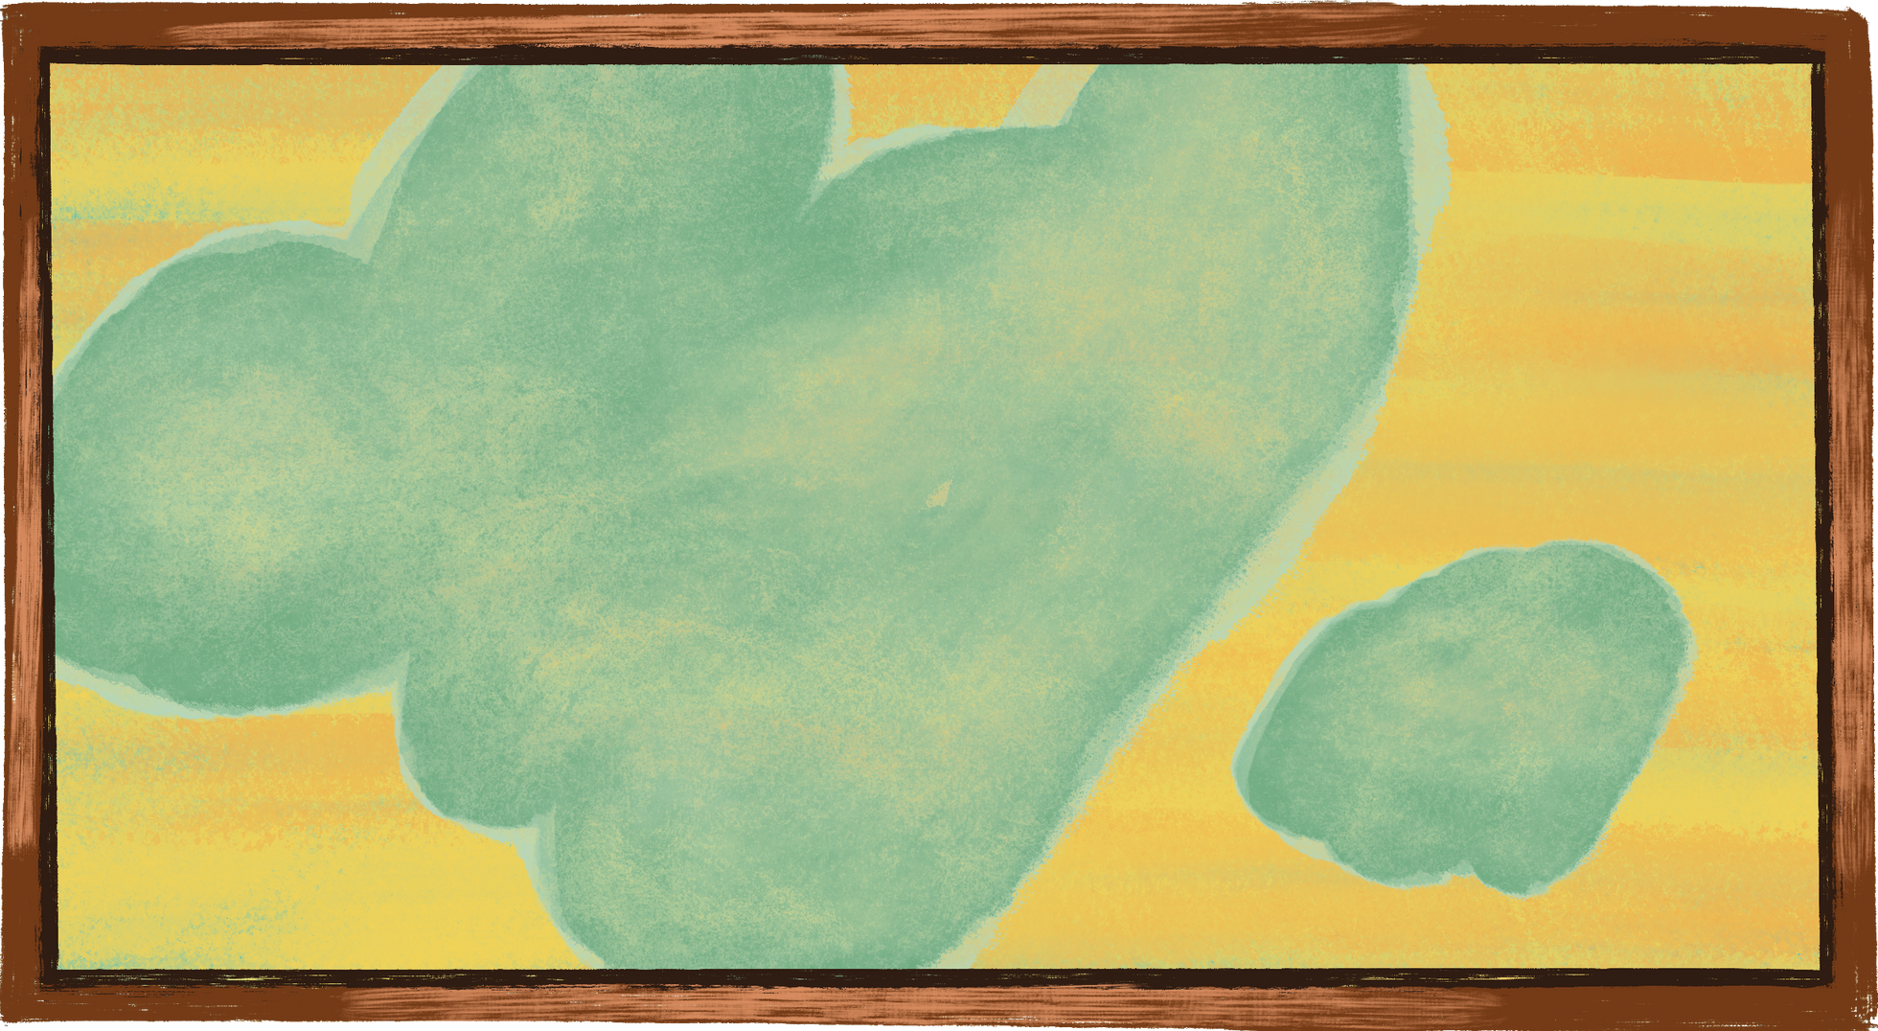




PICTA
LENS
By Ambert Chan

Slide 2
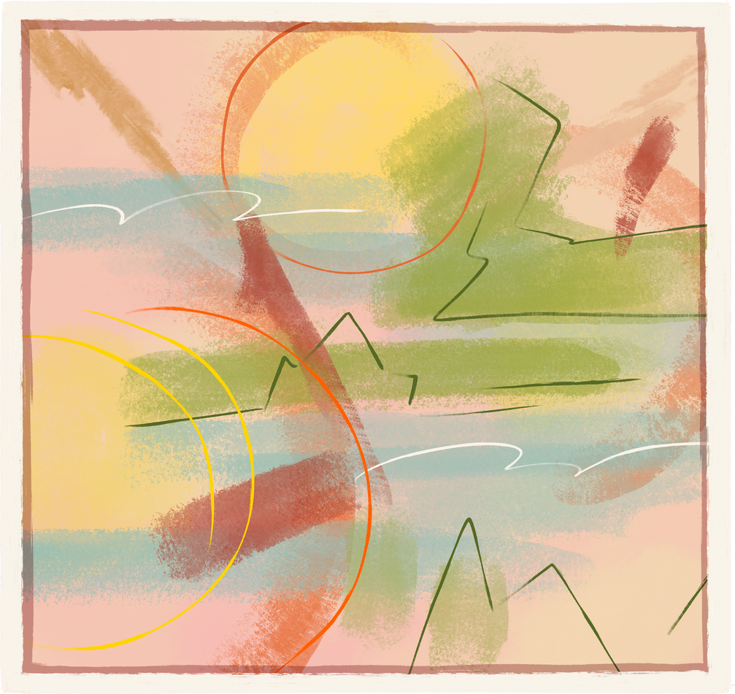
TIMELESS
CHRONICLES
Embark on a captivating visual voyage through the evolution of art, fashion, and digital creativity—from prehistoric cave paintings to cutting‑edge AI‑generated masterpieces

Slide 3
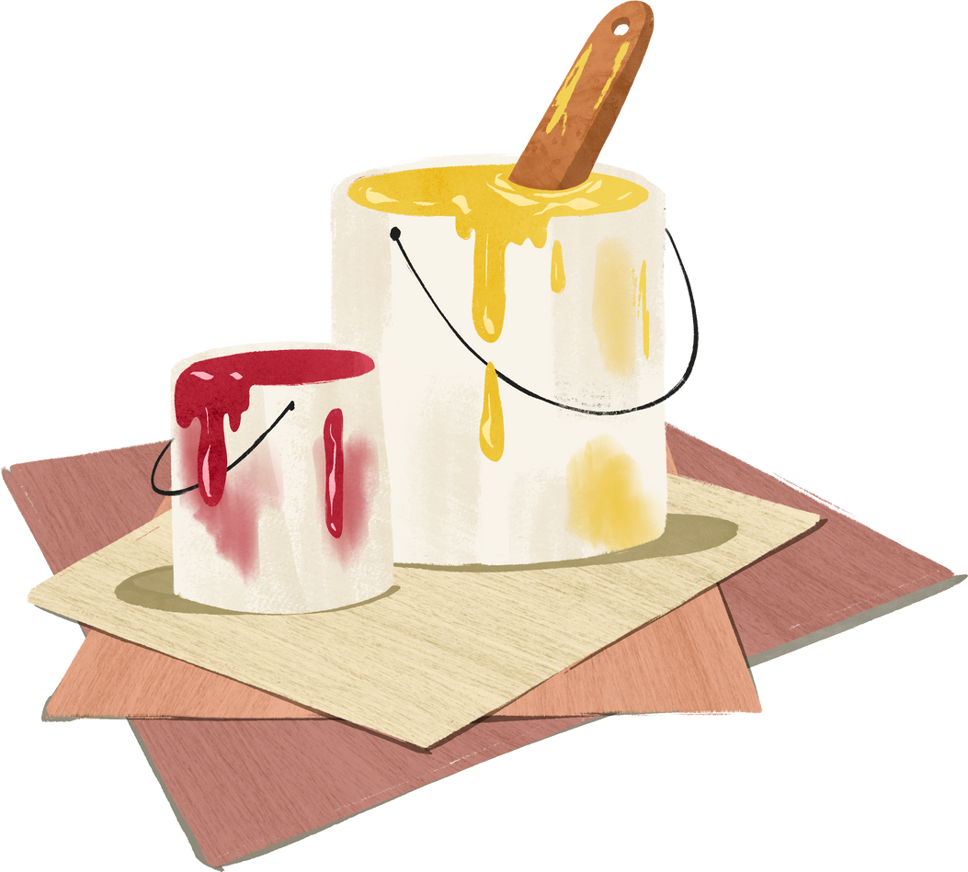
CONCEPT

Slide 4
Inspired by the journey of art from cave paintings to AI-generated works
Aims to connect history and technology through visual storytelling
Created to celebrate how creativity evolves across time
01.
STORY &
TARGETED
AUDIENCE
02.
Students & educators exploring art and history
Digital artists & AI enthusiasts
Creative minds seeking inspiration from past and future art

Slide 5

DEVELOPMENT
Tools & Technology
Enhancement
HTML
CSS
JAVASCRIPT
REACT
Light/Dark Mode toggle
Instagram-like system
3D parallax scrolling animation
Key Features
Smooth animations all around the website
AI image generation
Captivating UI design

Slide 6
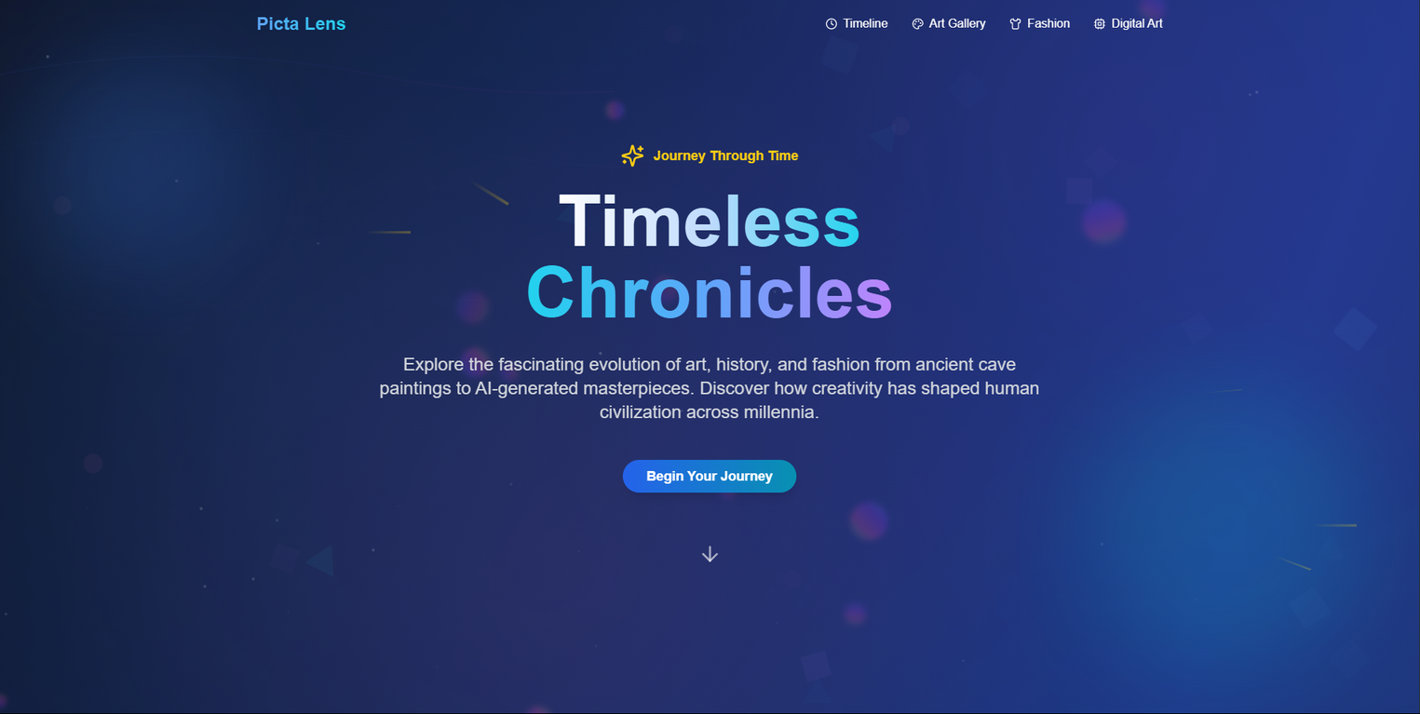
WEBSITE DEMO
nav bar to get to specific section
Begin the journey of the website
Hero Section

Slide 7
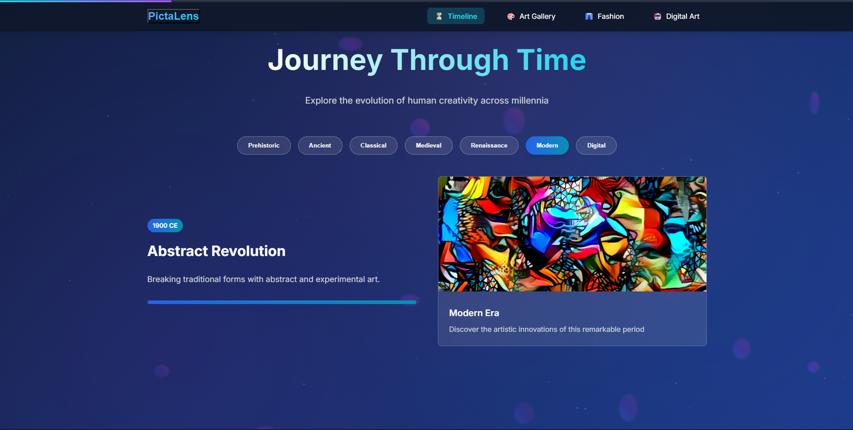
WEBSITE DEMO
Examine the evolution of artistic concepts across history
Timeine Section

Slide 8
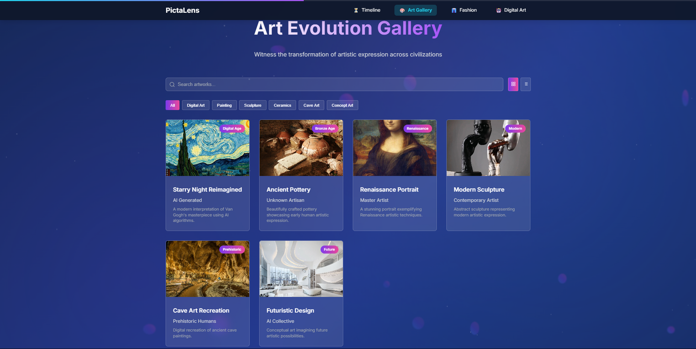
WEBSITE DEMO
Search and filter arts from different category
Display in grid or tile view
Art gallery Section

Slide 9
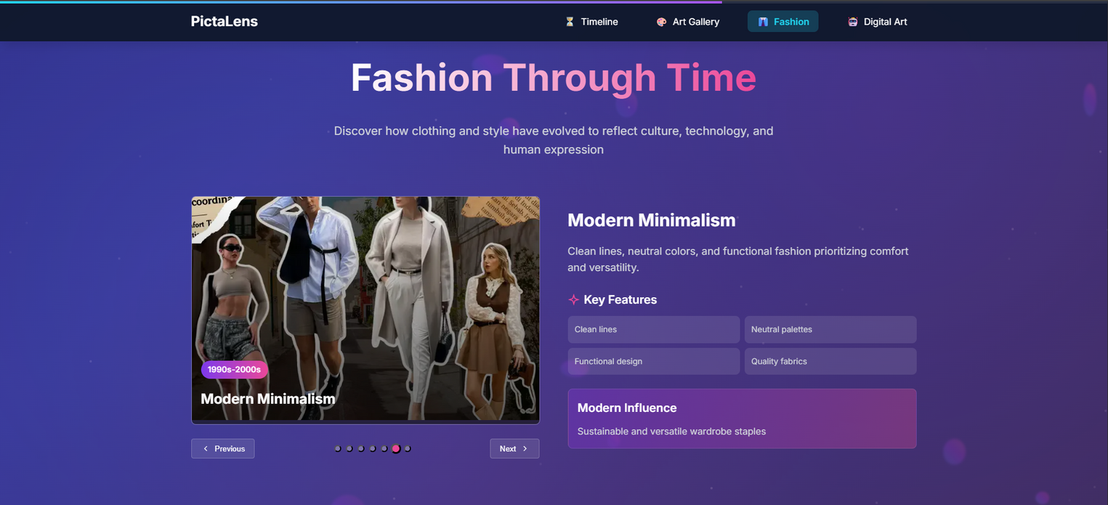
WEBSITE DEMO
A comprehensive overview of fashion trends from the past to the future
Fashion Section

Slide 10
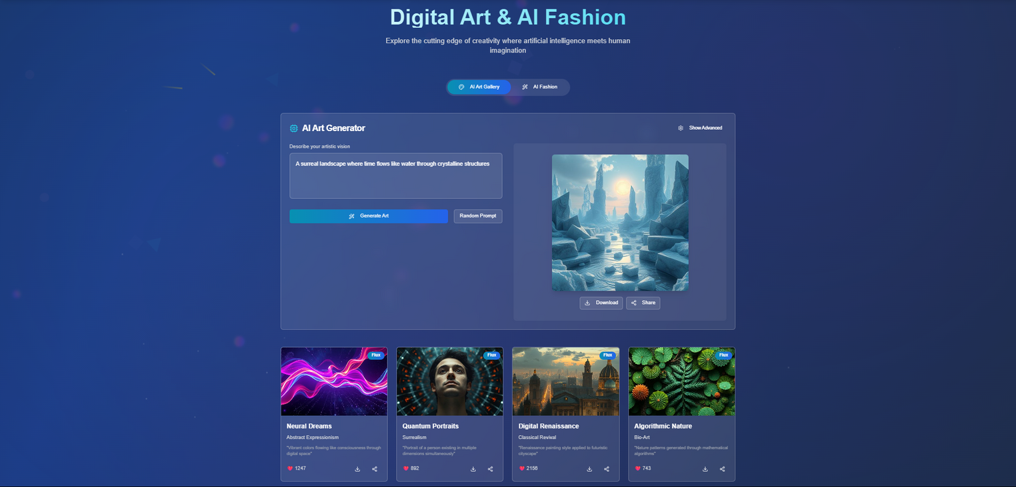
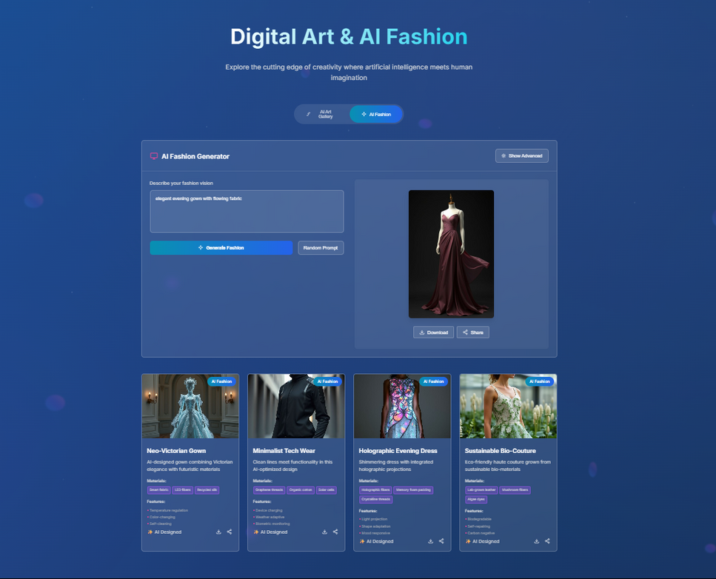
WEBSITE DEMO
Leveraging AI to create visual content and fashion designs
Ai Generation Section

Slide 11
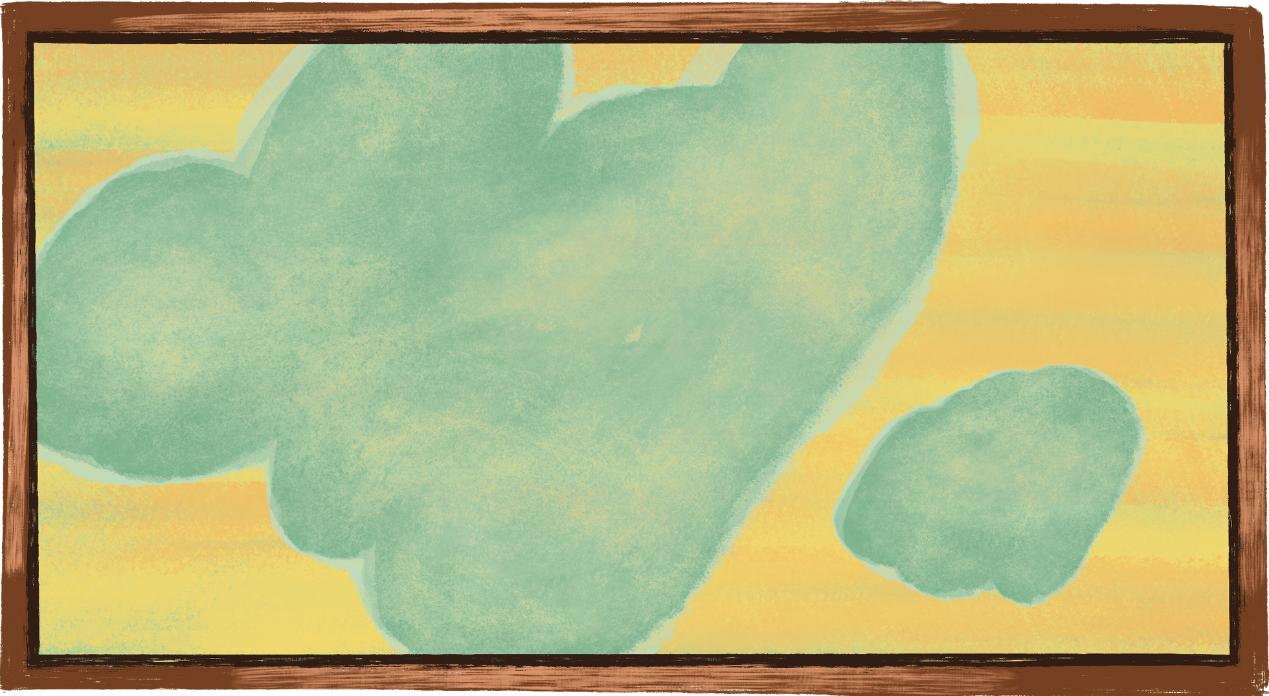
THANK YOU VERY MUCH!

